Slide 1
Comparative Analysis of Multiple Models for Skin Disease Detection
Priya Singh, Abhishek Basu, Hanisha Anil Mohinani, Utkarsh Farkya

Slide 2
Problem Statement
1. Need for Accurate Diagnosis: In dermatology, precise identification of skin diseases is crucial for effective treatment and management.
2. Lack of Comparative Analysis: Despite the availability of multiple models, there is a lack of systematic evaluation comparing their performance across key metrics like accuracy and computational efficiency.
3. Objective: This study aims to conduct a comprehensive comparative analysis of these models to determine the most effective and efficient approach for skin disease detection.

Slide 3
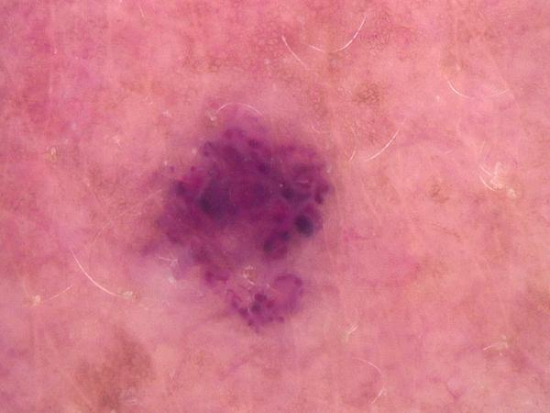
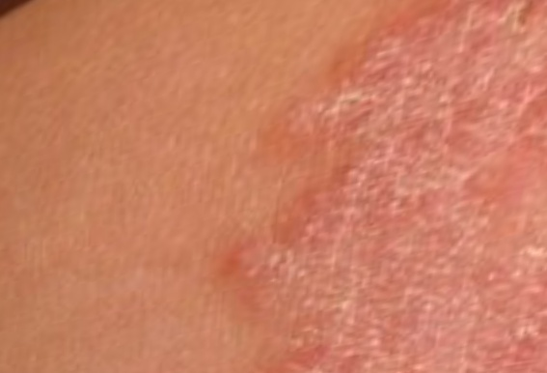
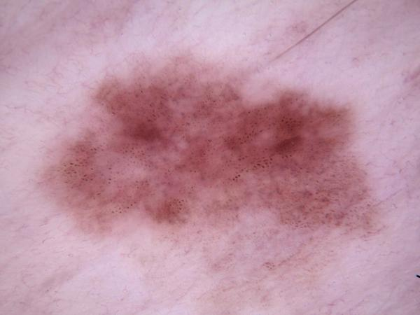
Dataset
This dataset consists of 878 labeled images and is curated from the International Skin Imaging Collaboration (ISIC) gallery, accessible at ISIC Archive. The data consists of 9 different classes namely,
Vascular Lesion
Tinea Ringworm
Candidiasis
Squamous cell
carcinoma
Fig. 1
Fig. 2
Fig. 3

Slide 4
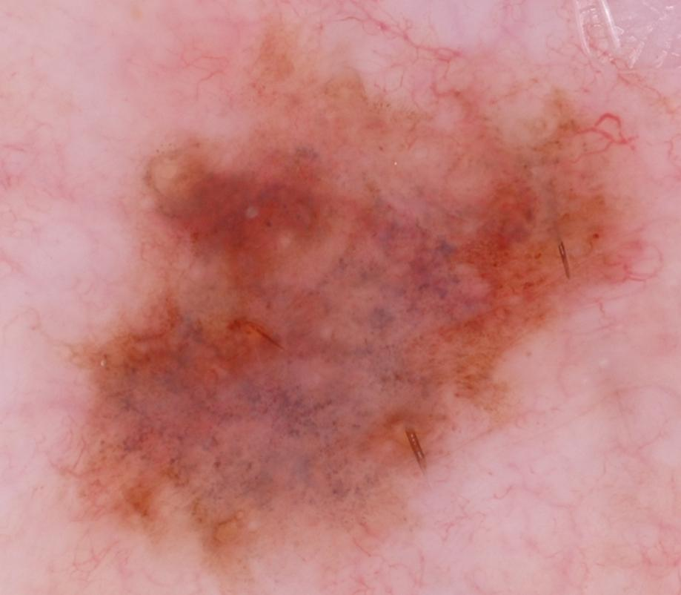
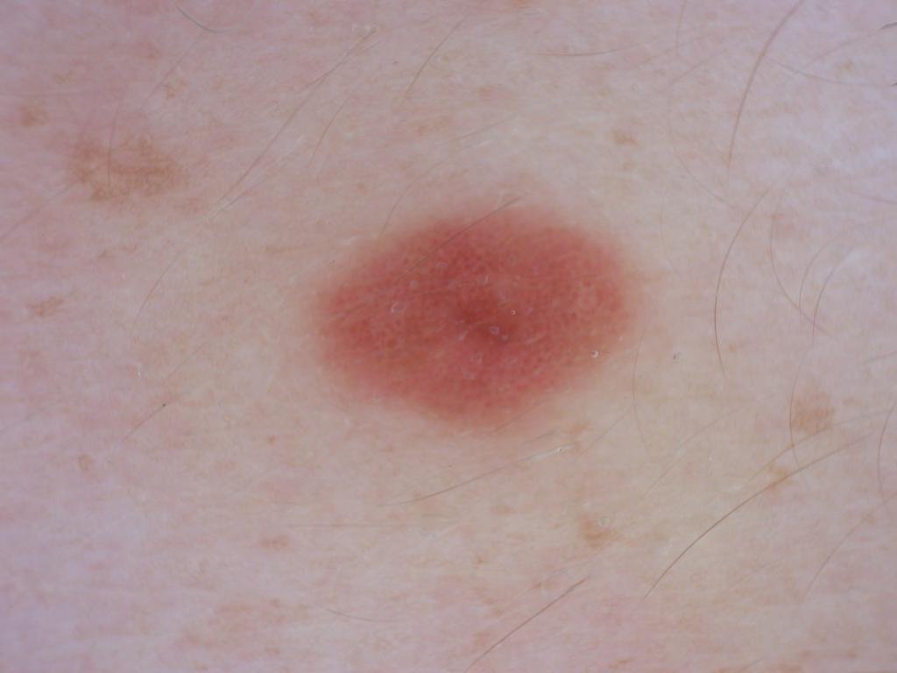
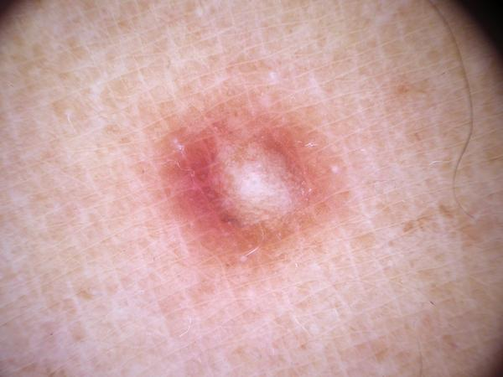
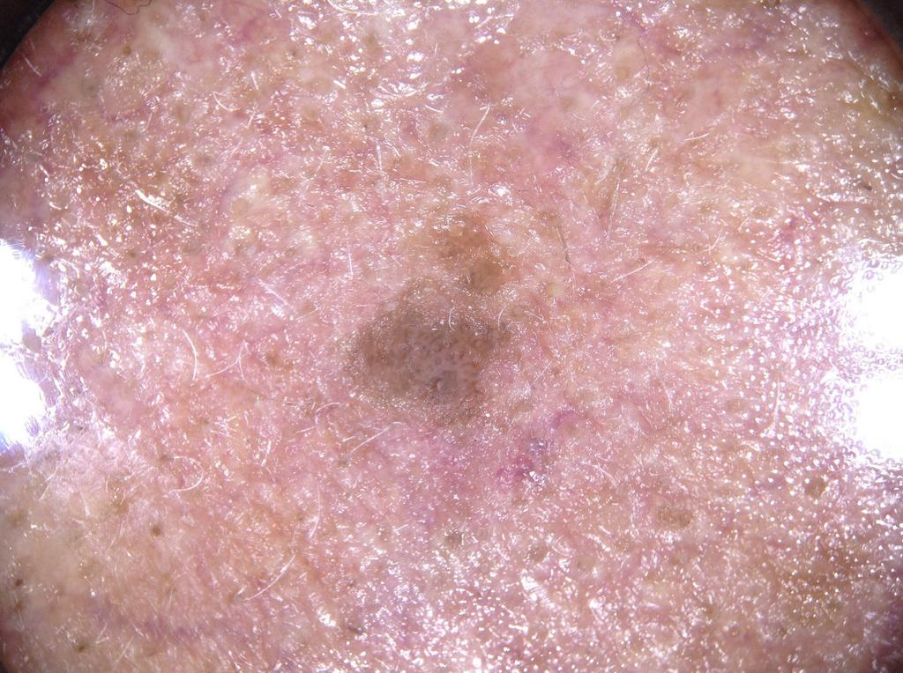
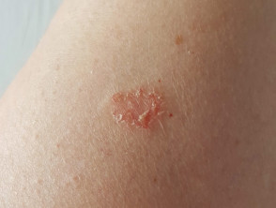
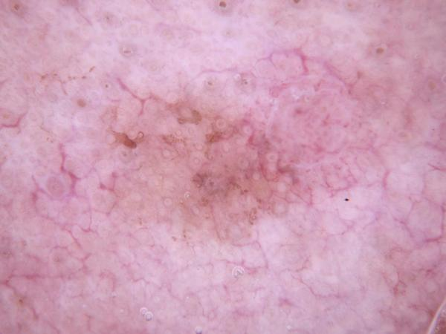
Dataset
Melanoma
Melanocytic nevus
Dermatofibroma
Benign keratosis
Fig. 4
Fig. 6
Fig. 7
Fig. 5
Atopic Dermatitis
Actinic keratosis
Fig. 8
Fig. 9

Slide 5
Methodology
Data Preparation: Processed and augmented the dataset for training ensuring consistency in size and format.
Model Selection: Compared CNN, MobileNet, DenseNet, ResNet 18, and ResNet 34 for skin disease classification.
Training and Evaluation: Trained each model with identical datasets, measuring accuracy and loss.
Performance Metrics: Compared model performance using confusion matrices, accuracy and other evaluative parameters.

Slide 6
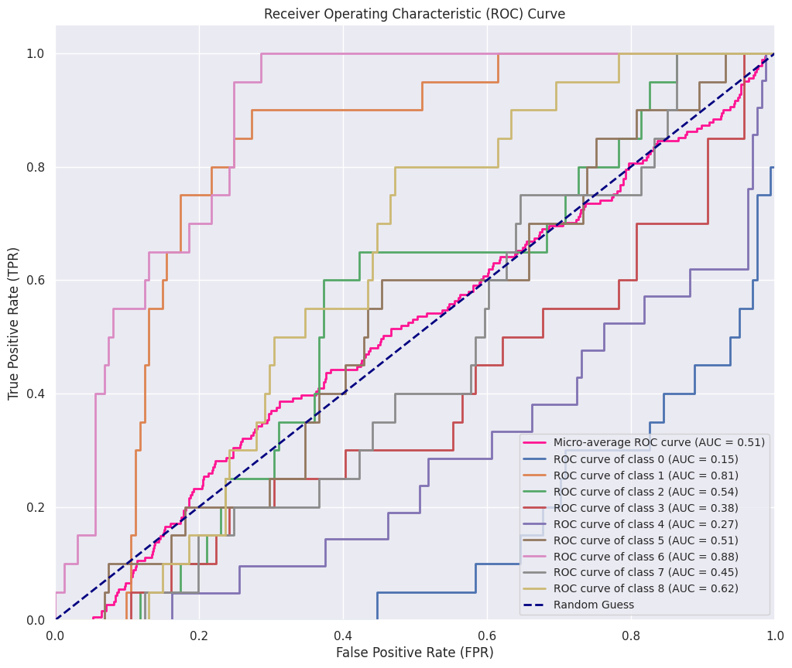
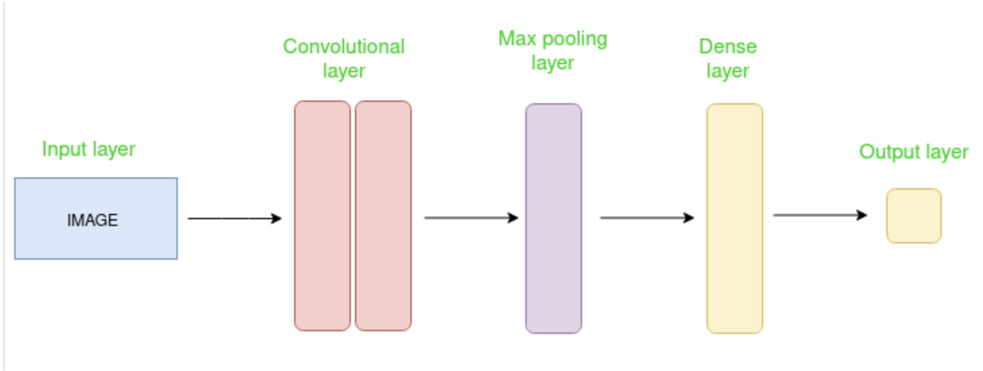
CNN Architecture and Overview
This CNN model consists of multiple convolutional layers followed by max-pooling and dropout layers, designed for image classification tasks. The architecture progressively extracts hierarchical features from input images while reducing spatial dimensions to control overfitting. Finally, fully connected layers classify the extracted features into one of 9 classes using softmax activation for multi-class classification.
Fig. x Dense connections
Fig 10. Architecture for CNN
Fig 11. ROC for CNN

Slide 7
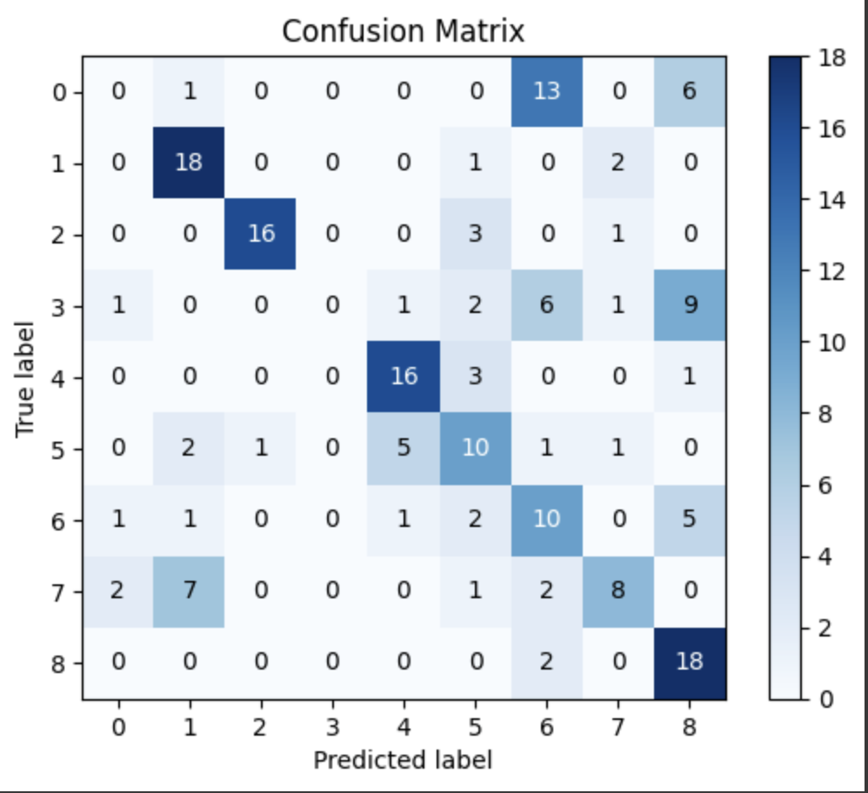
Analysis of CNN
Train accuracy | Test accuracy | Precision | Recall
70.94 | 53.04 | 45.46 | 53.03
Table 12. Model Results for CNN
Fig 13. Confusion Matrix for CNN
Notes:
Advantages:
Remove vanishing gradient problem
Feature Reuse
Reduced number of parameters
Disadvantages:
High computation
Susceptible to overfitting on small datasets
To avoid overfit:
Adjust learning rate
Gradually increase dropouts
Add more images to the dataset

Slide 8
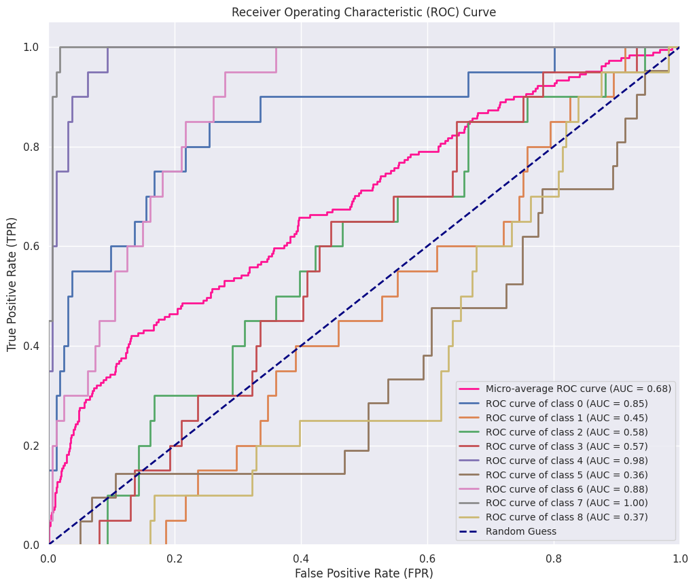
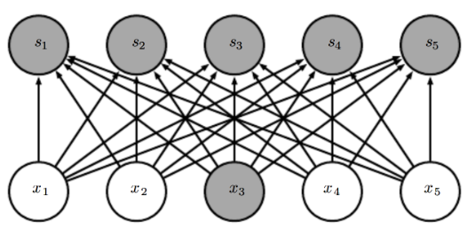
DenseNet Architecture and Overview
DenseNet is a type of convolutional neural network that utilises dense connections between layers using Dense Blocks. We connect all layers (with matching feature-map sizes) directly with each other. Each layer to every other layer in a feed-forward fashion.
Fig. 14 Dense connections
Fig 15. ROC for DenseNet

Slide 9
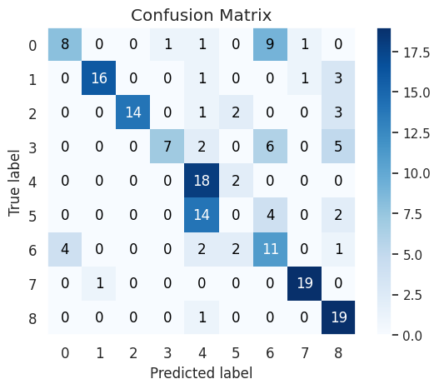
Analysis of DenseNet
Train accuracy | Test accuracy | Precision | Recall
73.97% | 61.33% | 32.66% | 33.86%
Table 16. Model Results for DenseNet
Fig 17. Confusion Matrix for DenseNet
Notes:
Advantages:
Remove vanishing gradient problem
Feature Reuse
Reduced number of parameters
Disadvantages:
High computation
Susceptible to overfitting on small datasets
To avoid overfit:
Adjust learning rate
Gradually increase dropouts
Add more images to the dataset

Slide 10
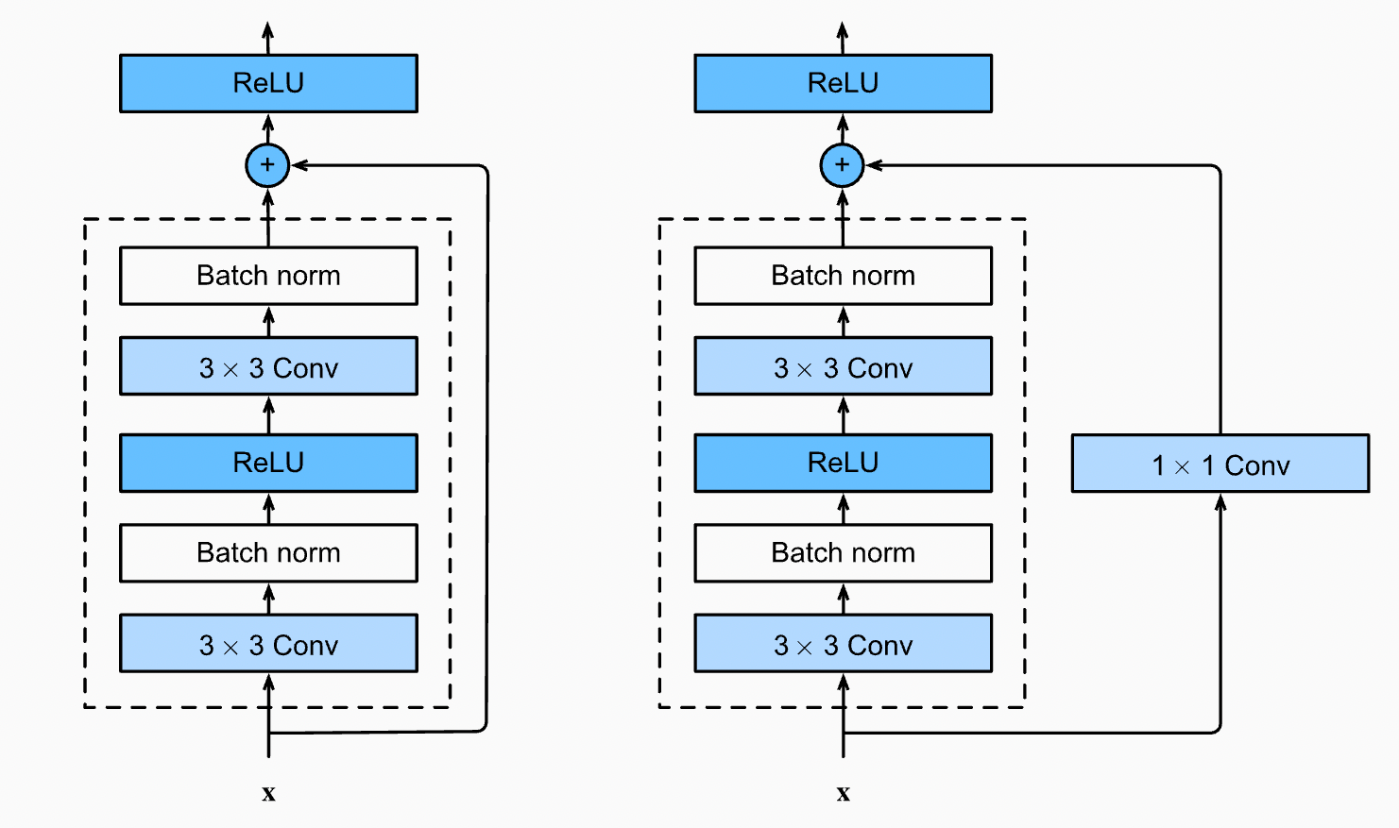
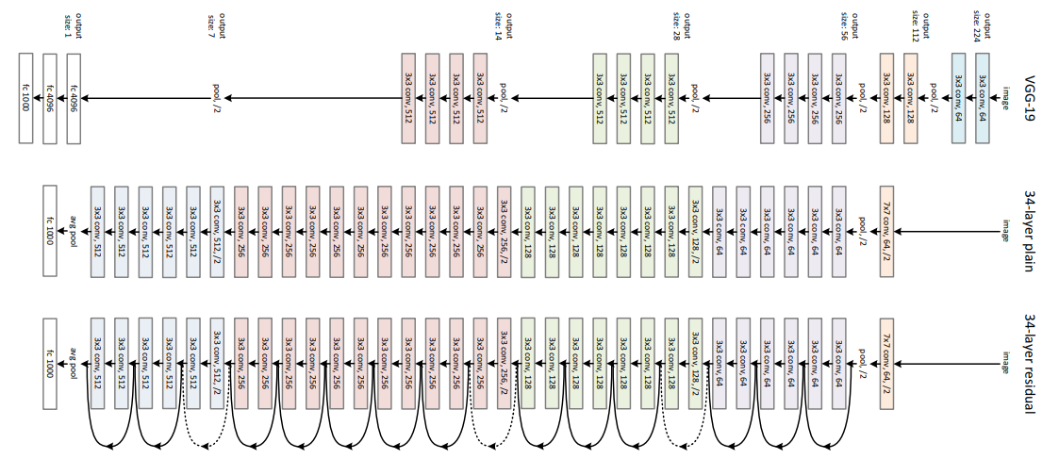
ResNet Architecture and Overview
ResNet is a type of convolutional network that can be considered as an upgraded version of VGG architecture, difference being that Resnet contains skip connections. Skip connections help in solving the vanishing gradient problem. Skip connection skips training from a few layers and connects it to the output.
Fig. 19 ResNet showing skip connections
Fig. 18 ResNet skip connections

Slide 11
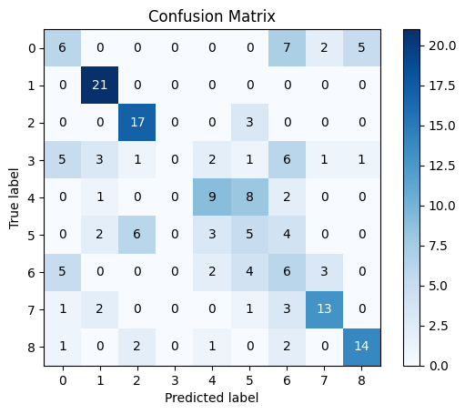
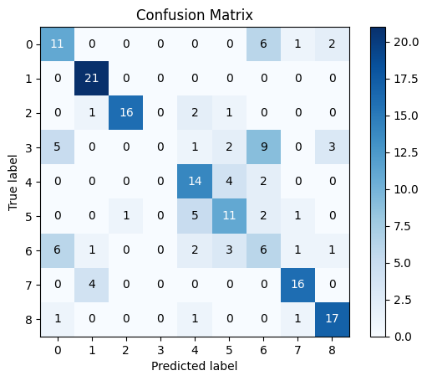
Results
 | Train accuracy | Test accuracy | Precision | Recall
Resnet 18 | 91.12% | 61.57% | 56.32% | 62.26%
Resnet 34 | 88.37% | 58.17% | 45.78% | 50.01%
Fig. 20 ResNet 34 Confusion Matrix
Fig. 21 ResNet 18 Confusion Matrix

Slide 12
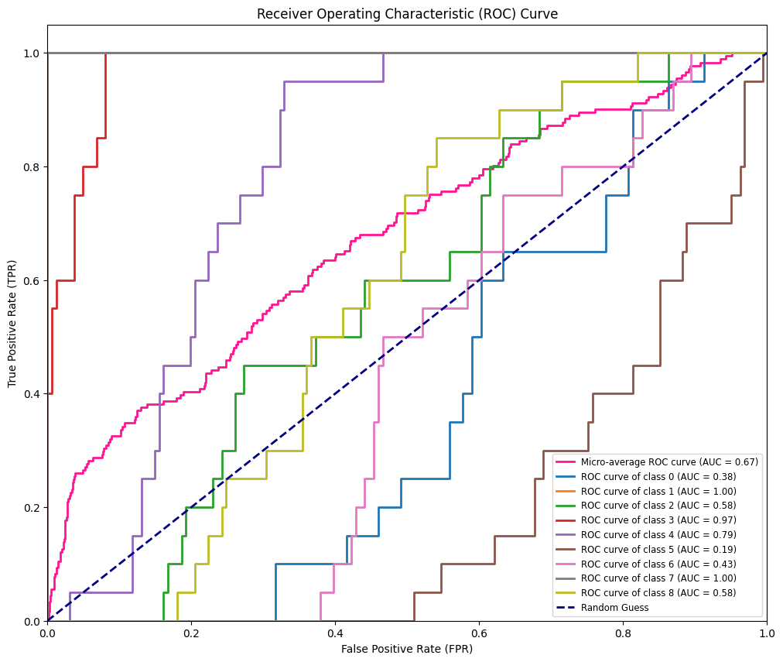
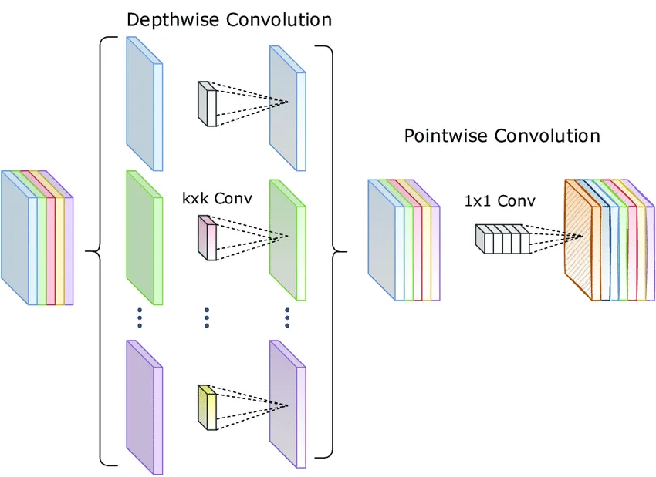
Analysis of MobileNet
MobileNet is a type of convolutional neural network (CNN) that uses depth-wise separable convolutions, reducing the computational cost while maintaining reasonable accuracy by splitting operations into depthwise and pointwise convolutions.
Fig. 22 ROC Curve for MobileNet
Fig. 23 Depthwise Separable Convolution
Notes:
Depthwise Convolution: Each color channel in an image (like red, green, and blue) gets its own filter. This step keeps the image's width and height the same, but changes how many color channels there are.
Pointwise Convolution: This step looks at all the new color channels and mixes them together. It uses tiny filters (1x1) to combine information from different channels and create the final result.

Slide 13
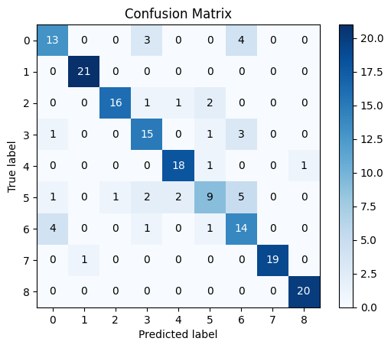
Analysis of MobileNet
Train accuracy | Test accuracy | Precision | Recall
96.84% | 80.11% | 80.58% | 80.01%
From the ROC curve, the model performed quite well and most classes had nice performance.
From the table, we can conclude that mobileNet has worked much better than other models.
Also, we can clearly see from the confusion matrix that most of the classes have been predicted correctly except a few classes.
Fig.24 MobileNet Confusion Matrix

Slide 14
Results(Continued)
Models/ Metrics | CNN | DenseNet | MobileNet | ResNet
 |  |  |  | ResNet 18 | ResNet 34
Train Accuracy | 70.94 | 73.97 | 96.84 | 91.12 | 88.31
Test Accuracy | 53.04 | 61.33 | 80.11 | 61.57 | 58.17
Precision | 45.46 | 32.66 | 80.58 | 56.32 | 45.76
Recall | 53.03 | 33.86 | 80.01 | 62.26 | 50.01
F-score | 47.59 | 30.47 | 79.97 | 59.07 | 47.21
Table 1. Summary of model parameters

Slide 15
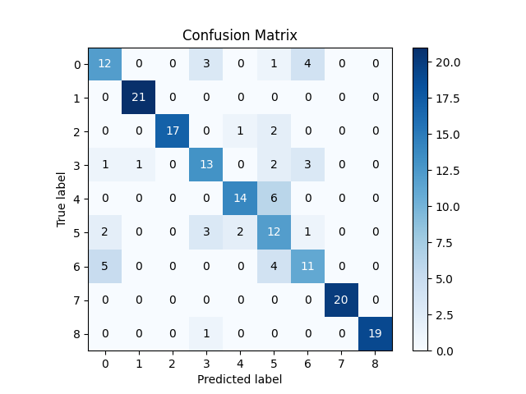
CNN Confusion Matrix
ResNet 34 Confusion Matrix
MobileNet Confusion Matrix
DenseNet Confusion Matrix
ResNet 18 Confusion Matrix

Slide 16
Conclusion
CNN: Basic implementation of neural network where we have implemented 3 blocks of convolution layer. Results in decent performance with a high number of misclassifications across the entire image dataset.
DenseNet: A very powerful tool employed on a small dataset makes it prone to overfitting. Adjusting dropout is a good solution but fails to achieve successful classification across all classes.
ResNet: State-of-the-art image classification model that works on small dataset but is able to generalize only on few classes. Introducing dropout blocks is a good idea to improve accuracy. Using a pretrained model and considering transfer learning can be a good solution too.
MobileNet: Works for small dataset but might lead to overfitting and reduced generalization. To improve, we need to consider data augmentation, transfer learning, and regularization techniques. This comes out to be the best model among the ones we have implemented in this project.

Slide 17
References
https://arxiv.org/abs/1608.06993v5
https://towardsdatascience.com/understanding-and-visualizing-densenets-7f688092391a
https://www.comet.com/site/blog/an-intuitive-guide-to-convolutional-neural-networks/
https://medium.com/@pandrii000/mobilenet-architectures-17fe7406d794
https://www.comet.com/site/blog/an-intuitive-guide-to-convolutional-neural-networks/
https://ieeexplore.ieee.org/document/8862403
https://ieeexplore.ieee.org/document/1004763

Slide 18
Q/A

